Slide 1
Module 4
Geospatial Displays
116N54C301

Slide 2
Geospatial displays
The Heat Map
Maps
Connecting to Geographic Data
Assigning Geographic Roles
Creating Geographic Hierarchies
Proportional Symbol Maps
Choropleth Maps

Slide 3
Geospatial Analysis
Geospatial analysis is the gathering, display, and manipulation of imagery, GPS, satellite photography and historical data, described explicitly in terms of geographic coordinates or implicitly, in terms of a street address, postal code, or forest stand identifier as they are applied to geographic models
Applications:
crisis management
climate change modeling
weather monitoring
sales analysis
human population forecasting
animal population management.

Slide 4
Geospatial displays
The Heat Map :
Visualise data through variations in colouring.
Useful for cross-examining multivariate data, through placing variables in the rows and columns and colouring the cells within the table.
Good for showing variance across multiple variables, revealing any patterns, displaying whether any variables are similar to each other, and for detecting if any correlations exist in-between them

Slide 5
Benefits of Heat Maps
Analytics tools like Google Analytics or SiteCatalyst are great at providing metrics to show which pages users visit, but they can lack detail when it comes to understanding how users engage with those pages. Heatmaps can give a more comprehensive overview of how users are really behaving.
A lot more visual than standard analytics reports, which can make them easier to analyze at a glance.
More accessible, particularly to people who are not accustomed to analyzing large amounts of data.

Slide 6
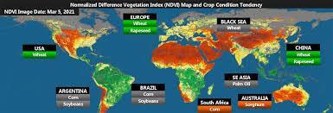
Geospatial displays
The Heat Map :
A heat map graph is a great way to compare categorical data using color
Similar to the tree map, a heat map represents the values by a variable in a hierarchy.
Typically used to represent weather reports

Slide 7
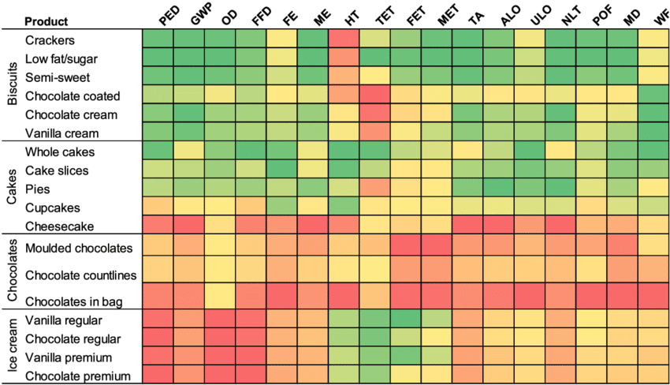
Geospatial displays
The Heat Map :
NOT restricted only for weather

Slide 8
Geospatial displays
The Heat Map :
For navigating heat map as a visualization tool include:
Can be used effectively when a large amount of data is available
It is important to have enough information to ensure that any anomalies do not affect the overall heatmap picture
Adding a size variation for squares to show the concentration of intersecting factors while adding a third element.
Using a shape other than a square to convey meaning in a more impactful way.
As with other forms of quantitative data, heatmaps can tell you what has happened on a page, but cannot tell you why that happened.

Slide 9
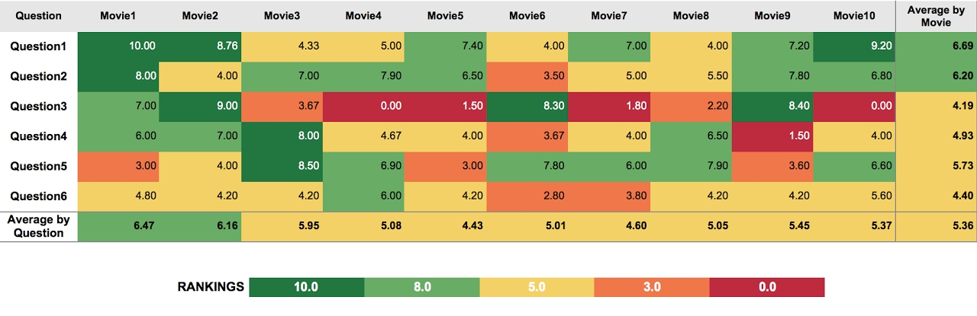
Geospatial displays
The Heat Map : examples

Slide 10
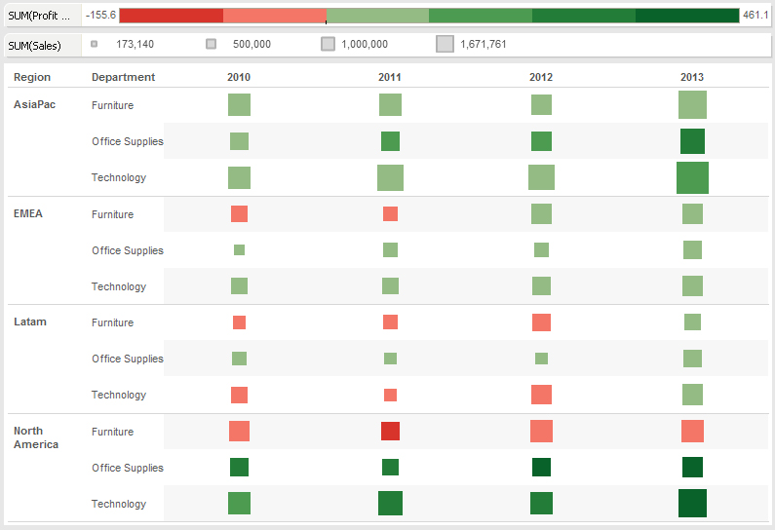
Geospatial displays
The Heat Map : examples

Slide 11
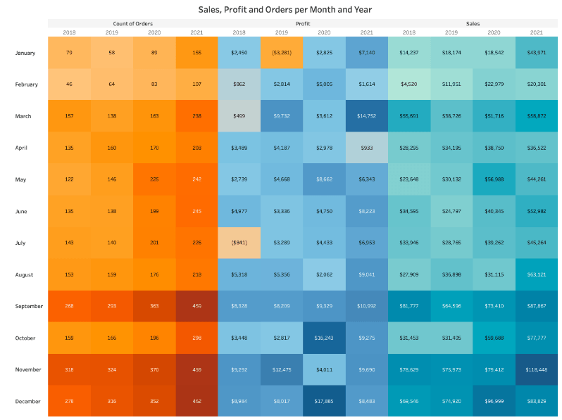
Geospatial displays
The Heat Map : examples

Slide 12
What is heat map analysis?
The process of reviewing and analyzing heat map data to gather insights about user interaction on the page.
Can lead to improved site designs with lower bounce rates, fewer drop-offs, more pageviews, and better conversion rates.
Results can be even more effective by running usability tests (like A/B testing:a method of comparing two versions of a web page or app against each other to determine which one performs better.).

Slide 13
Heat map analysis
Carried out by asking:
Are visitors seeing important content?
To understand if people are actually seeing important content elements or sections on your page, take a look at a scroll map—i.e., the heat map that shows you how far down the page people scroll.
Start by reviewing the position of the average fold, which is the portion of the page people see on their screen without scrolling as soon as they land on your site:

Slide 14
Heat map analysis
Carried out by asking:
Are people clicking on key page elements (links, buttons, and CTAs)?
a click map quickly confirms if users are clicking on them or not:

Slide 15
Heat map analysis
Carried out by asking:
Are people confused by non-clickable elements?
Non-clickable elements that look like they might be clickable can cause confusion and frustration for users who waste their clicks while expecting to be taken elsewhere using mouse tracking heat maps

Slide 16
Heat map analysis
Carried out by asking:
Are people getting distracted?
Identifying where exactly visitors are watching on the web page using eye-tracking heat maps

Slide 17
Heat map analysis
Carried out by asking:
Are people experiencing issues across devices?

Slide 18
Types of website heatmap data visualization
Due to their dynamic and robust nature, website heatmaps enable the graphical representation of data in many forms based on the nature of the data sets.
Businesses use website heatmaps with an online presence to visualize the visitors’ clicks, scrolls, mouse and eye movement, and so on, on their website, in real-time.
Visitor interaction on web pages is visualized in
Heatmaps
Scrollmaps
click maps
mouse-tracking heatmaps
eye-tracking heatmaps.

Slide 19
Heatmap
Heatmap is a graphical way to visualize visitor behavior data in the form of hot and cold spots employing a warm-to-cool color scheme.
The warm colors indicate sections with the most visitor interaction, red being the area of highest interaction, and the cool colors point to the sections with the lowest interaction.

Slide 20
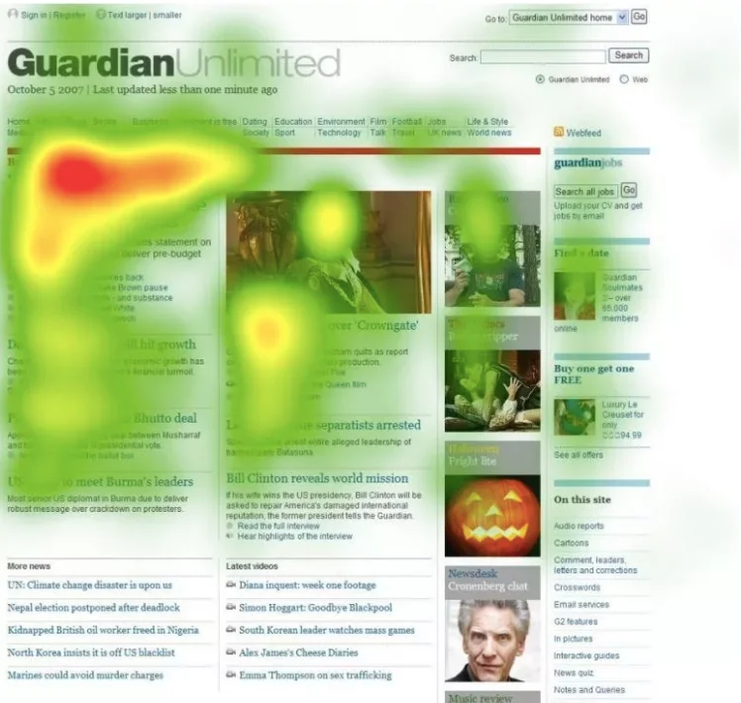
Heatmap

Slide 21
Scroll map
Scroll maps visually present the state of your webpages in the form of a heatmap where all the scroll data (scroll depth, scrolling pattern, etc.) are plotted.
A scroll map indicates the number of visitors scrolled to each section of a webpage, the section after which the percentage of people scrolling drastically falls, the maximum depth till which people scrolled, and more. This data is visualized using colors in a single scroll map, with each color signifying varying intensity of interaction.

Slide 22
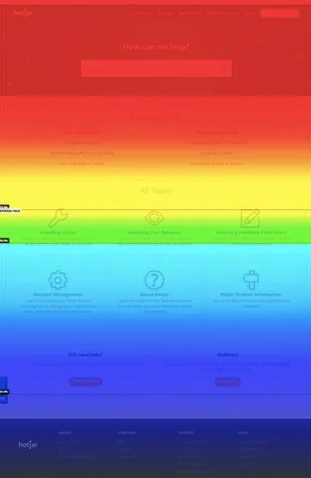
Scroll map

Slide 23
Click map
Website heatmaps also offer click maps that track and visualize click data on the web pages to help to understand visitor behavior at a granular level.
Click maps visually presents clicks on each element of a page like clicks on links, missing/broken links, images, Call to action (CTA), pop-ups, and so on.
With each and every click registered on the webpage, click maps present multiple variables and data points in one single heatmap.

Slide 24

Click map

Slide 25
Mouse tracking heatmap
A color-coded heatmap is generated that visualizes mouse movement data of each visitor as well as data where the individual reports are combined to trace patterns in the mouse movement of the visitors.
At the most general level, mouse tracking heatmaps visualize where visitors’ cursor hovers the most, which section/s of a webpage the cursor keeps coming back to, and more such mouse movement data.

Slide 26
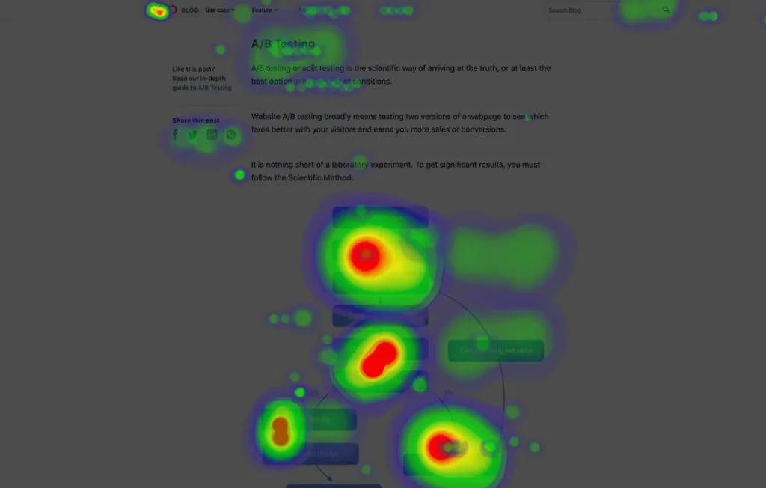
Mouse tracking heatmap

Slide 27
Eye-tracking heatmap
Like mouse tracking heatmap, eye-tracking heatmap also visualizes viewing patterns, but instead of cursor data, data on visitors’ gaze is visualized. Eye-tracking heatmap tracks visitors’ eye movement and visualizes gaze data.
These data include fixation length based on the number of times an image is looked at, which elements attract the visitor’s gaze the most, which irrelevant elements are distracting the visitors’ eye away from the main CTA, and so on.

Slide 28
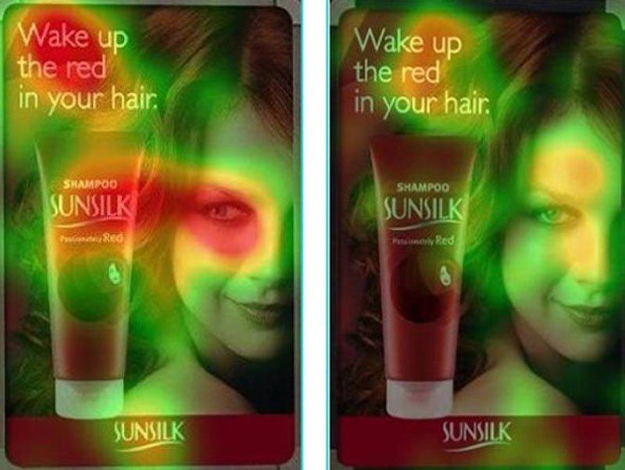
Eye-tracking heatmap

Slide 29
The benefits of using heat maps on website
Heatmaps help to understand how people interact with website pages, to find answers to business-critical questions such as ‘why are users not converting?’ or ‘how to get more visitors to take action?’
Heat maps can be used to determine if the visitors are:
Reaching important content or failing to see it
Finding and using a page’s main links, buttons, opt-ins, and CTAs
Getting distracted by non-clickable elements
Experiencing issues across devices
help
to be informed
to take data-based decisions for A/B testing
in updating, or (re)designing website.
to show team members and stakeholders what’s happening and get their buy-in more easily when changes are needed

Slide 30
Geospatial displays
Maps
Used to analyze or present data geographically,
Used to display geographic data or as a way to communicate answers to spatial questions such as country, state or any other geographical locations
Before beginning to build a map, be sure to take a careful look at data, analysis, and story
Ensure “appropriate data representation” and “attractive data representation”
Maps can be particularly tricky in their tendency to mislead or inadvertently cause people to misinterpret the data, or to dictate a not-quite-true story.

Slide 31
Geospatial displays
Connecting to Geographic Data
Geographic data is information mapped around a sphere.
Geographic data highlights the latitude and longitude relationships to a specific object or location
Spatial data is any type of data that directly or indirectly references a specific geographical area or location.
Sometimes called geospatial data or geographic information, spatial data can also numerically represent a physical object in a geographic coordinate system. However, spatial data is much more than a spatial component of a map.
A geographic information system (GIS) is a computer system for capturing, storing, checking, and displaying data related to positions on Earth's surface.
By relating seemingly unrelated data, GIS can help individuals and organizations better understand spatial patterns and relationships

Slide 32
Geospatial displays
Connecting to Geographic Data

Slide 33
Geospatial displays
Assigning Geographic Roles
All geographic fields should have a data type of string, a data role of dimension, and be assigned the appropriate geographic roles.
The exception is latitude/longitude, which should have a data type of number (decimal), a data role of measure, and be assigned the Latitude and Longitude geographic roles.
Geographic fields could be State and County string type data could be adjusted to State field to the Geographic Role of State and the County field to the Geographic Role of County
Tableau will also assign a latitude and longitude to each location

Slide 34
Geospatial displays
Creating Geographic Hierarchies
Hierarchy can be created such as
Country- State- District- City
Region- state - county
This will help in understanding the data in better manner

Slide 35
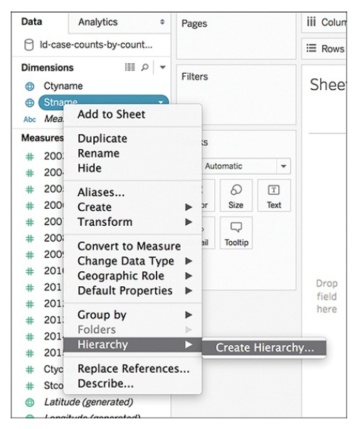
Geographic Hierarchy

Slide 36
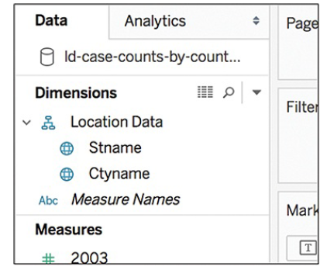
Geographic Hierarchy

Slide 37
Geospatial displays: Proportional Symbol Maps
Merits:
Used to show quantitative values for individual locations
Useful for illustrating differences between many places
Data associated with a specific location
Visually appealing
Can be encoded with visual cues like size and color
Can show one or two quantitative values per location
Easy to read as each symbol is proportional to it's value
Limitations:
Difficult to calculate actual value (if not shown)
Time-consuming to construct
Size may obscure location or mean less accurate positioning on maps

Slide 38
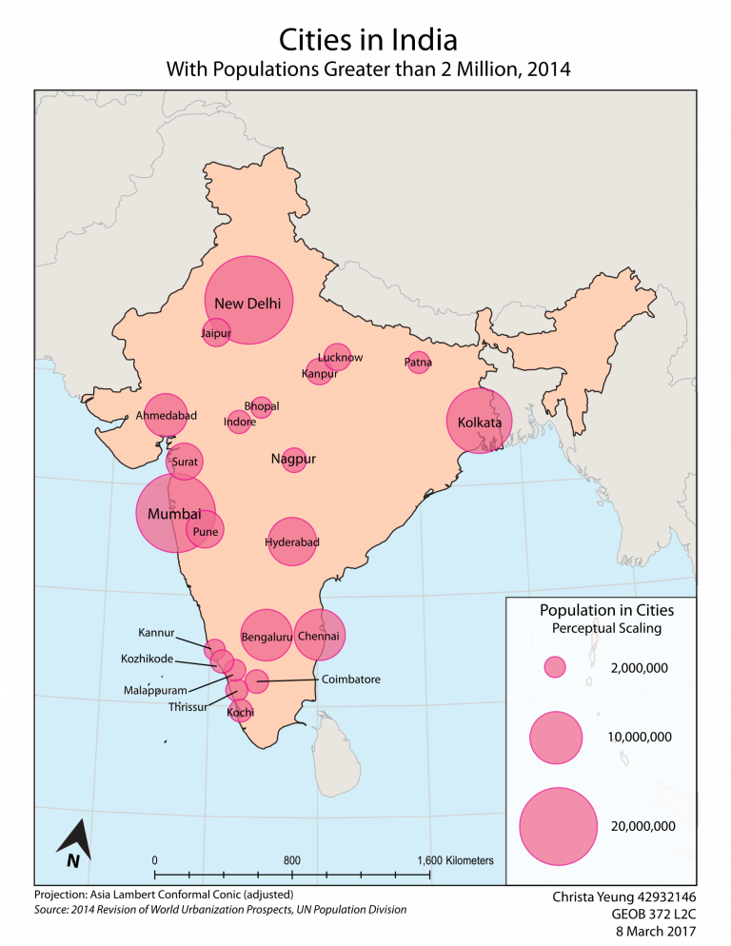
Proportional Symbol maps

Slide 39
Geospatial displays: Choropleth Maps
A great tool for showing ratio or aggregated data.
Use shading and coloring within geographic areas to encode value to a quantity in those areas.
A dataset should include both quantitative and qualitative values, along with location information recognizable by Tableau

Slide 40
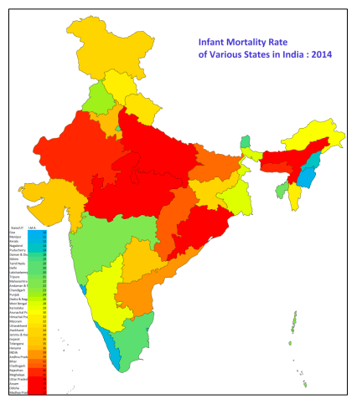
Choropleth maps

